Slide 1

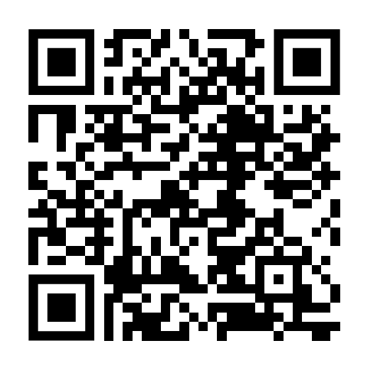
MQTT4SSN: An Ontology for the MQTT Message Protocol
Prof. Dr. Maria Maleshkova
M. Sc. Niklas Dörner
https://doernern.github.io/MQTT4SSNOntology/documentation/index-en.html
Data Engineering
Notes:
Über den Link / QR-Code ist die Dokumentation zu erreichen. GitHub liegt unter https://github.com/doernern/MQTT4SSNOntology/

Slide 2
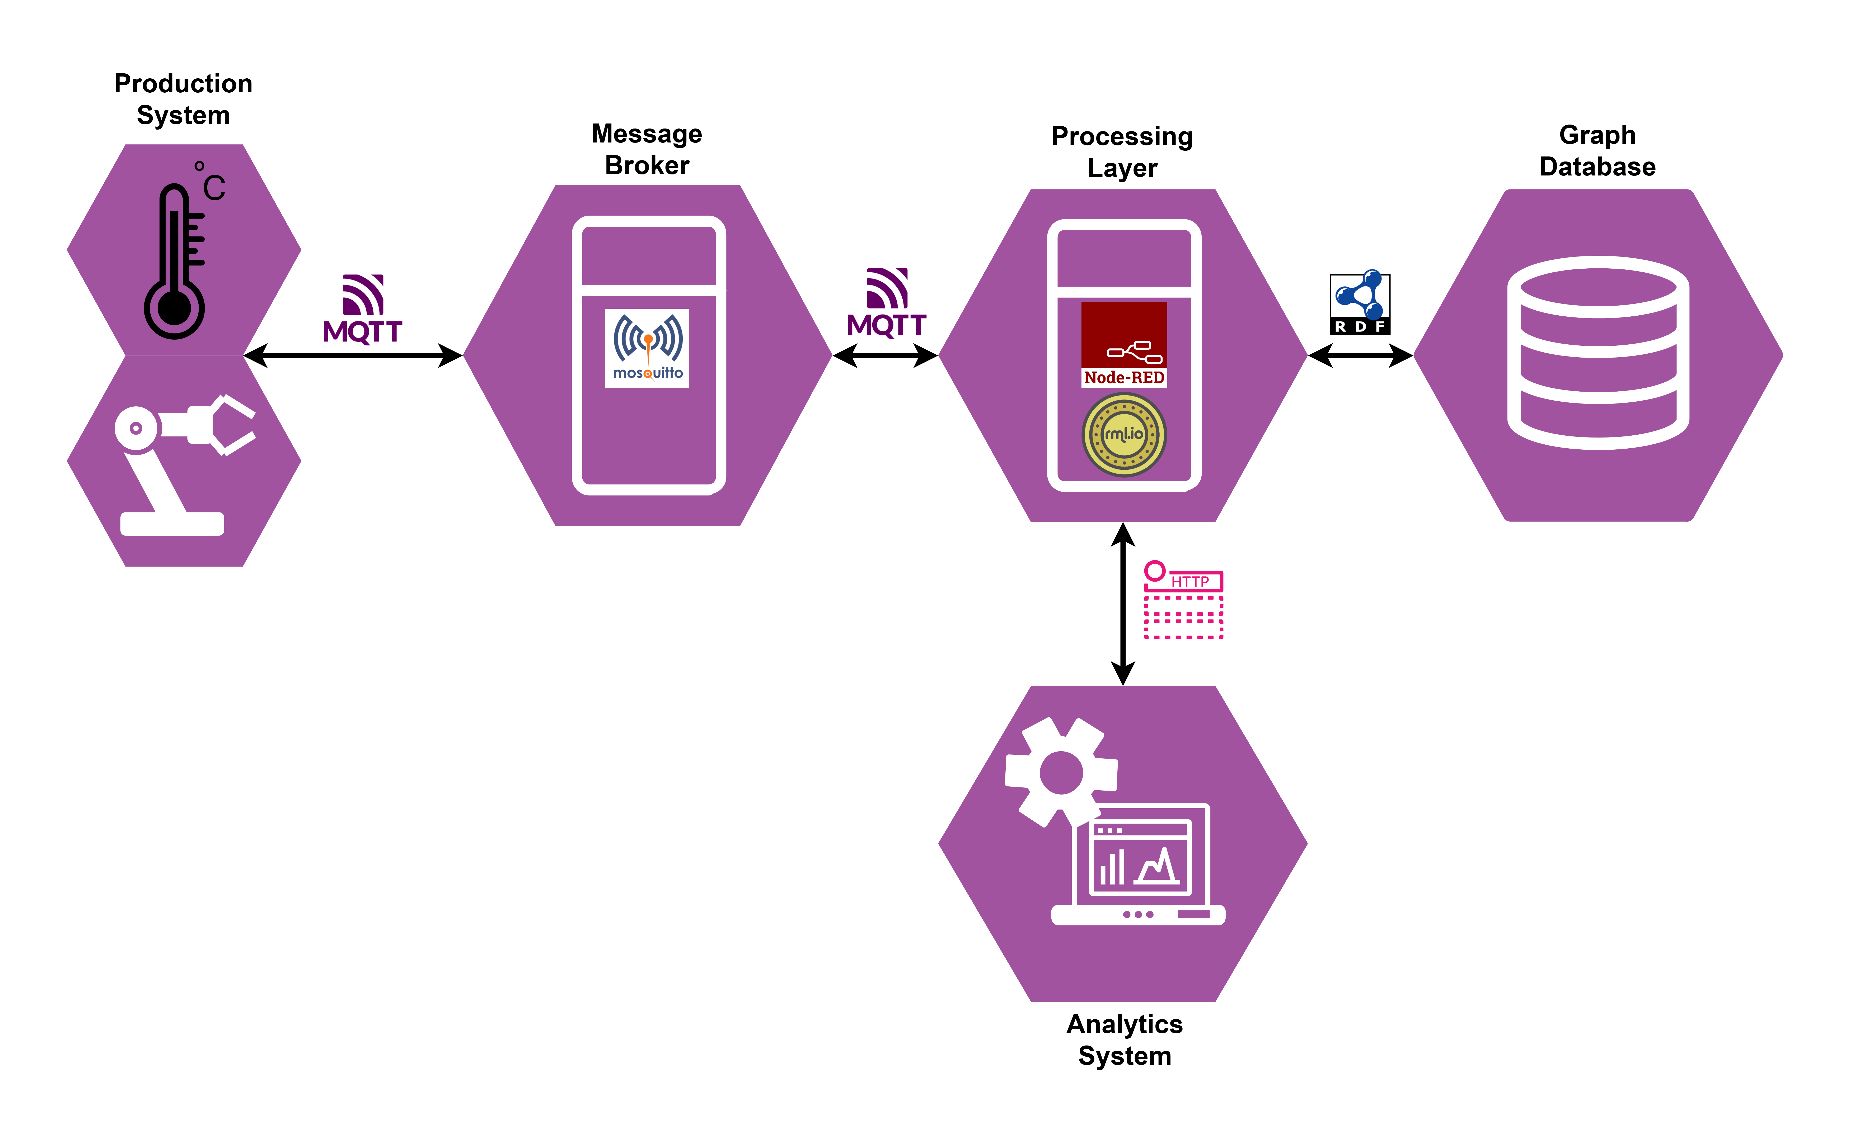
Use Case: Automated Production Systems
Data Engineering
2

Slide 3
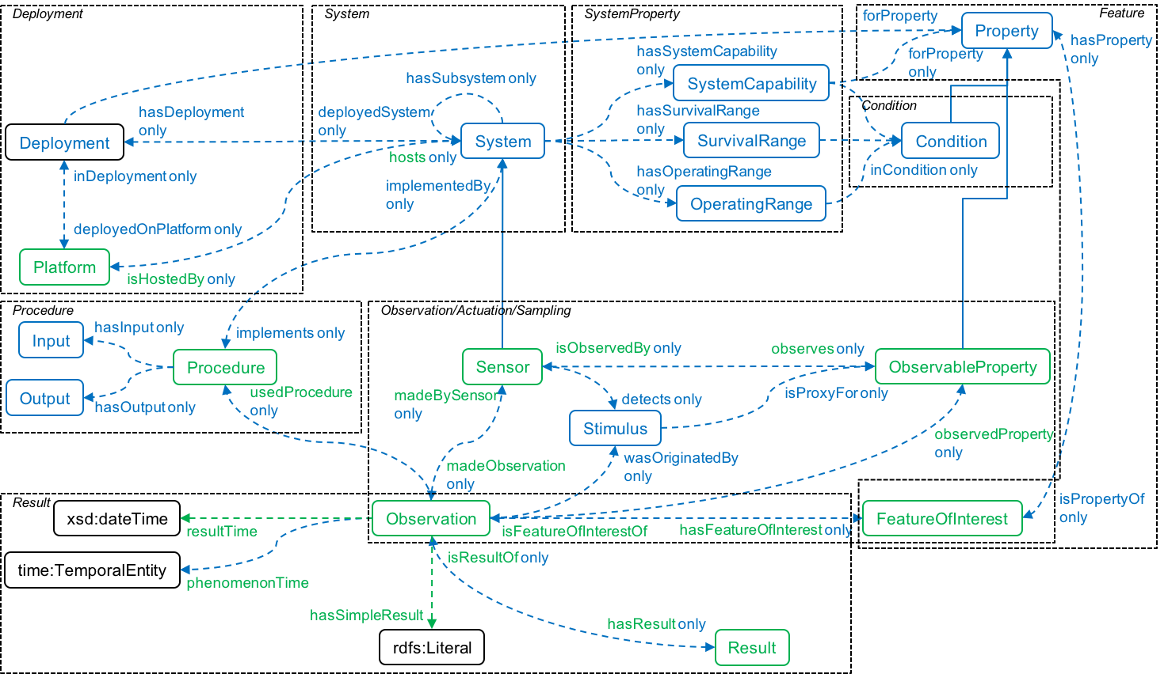
Introduction: W3C SSN/SOSA ontology
W3C Recommandation 2017, W3C Editors’s Draft 2023 Edition
Foundational framework for representing semantic sensor networks
Physical systems, sensor deployments, observational, and actuation processes
SOSA serves as a lightweight core, while SSN adds richer axioms
Does not include M2M communication protocols
Source: https://www.w3.org/TR/vocab-ssn/
Data Engineering
3
Notes:
machine-to-machine (M2M)

Slide 4
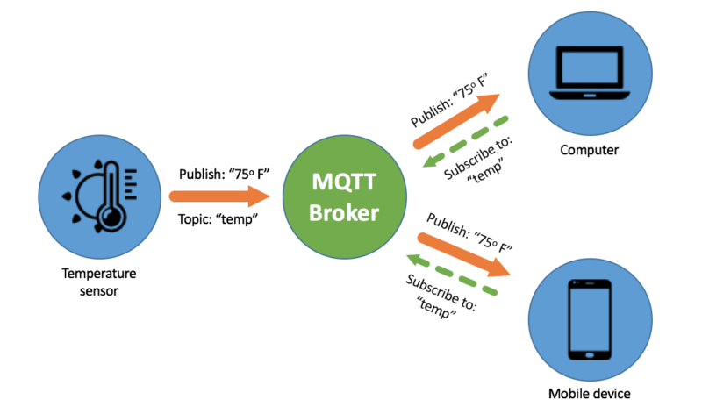
Introduction: MQTT
Message Queuing Telemetry Transport (MQTT), OASIS standard
Lightweight message protocol over TCP/IP transport protocol
Designed for M2M and IoT context, widely adopted in the industry
Publish-subscribe model with four main components:
Publisher and Subscriber (Clients), Broker, and Topic
15 different Control Packets with fixed and variable Headers and Payload
QoS levels, Retain and DUP flags
https://www.innorobix.com/message-queuing-telemetry-transport-mqtt/
Data Engineering
4
Notes:
MQTTv5: 15 different Control Packets ; MQTTv3.1.1: 14 different Control Packets

Slide 5
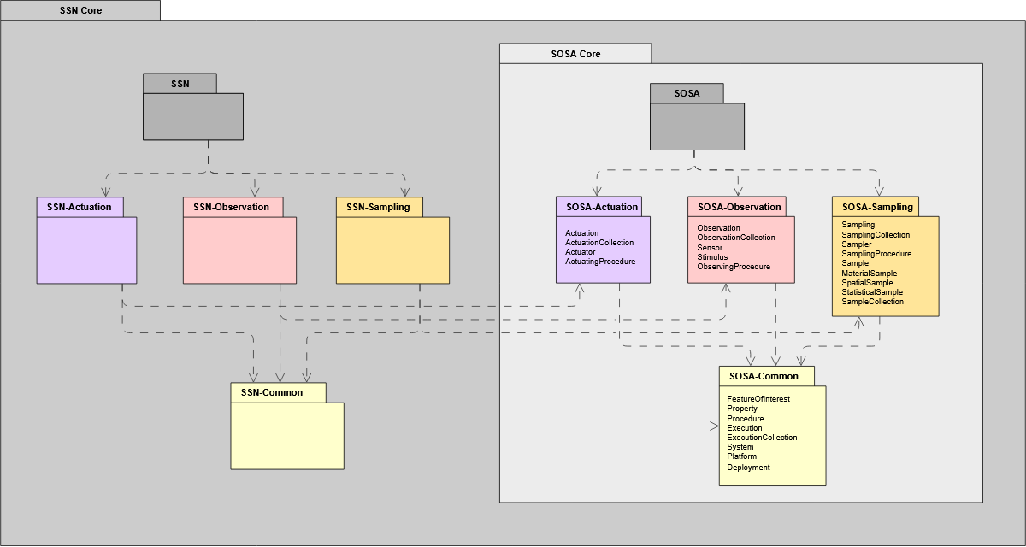
Research Question 1
SSN/SOSA‘s missing transport component
Extend SSN/SOSA with MQTT elements
Enable seamless alignment between observation and actuation process descriptions with transport semantics
RQ1: How can the MQTT message protocol be semantically represented in a way that aligns with an existing sensor network ontology, such as W3C SSN/SOSA?
Source: https://w3c.github.io/sdw-sosa-ssn/ssn/
Data Engineering
5
Notes:
In the picture you can see that there is no transport component yet

Slide 6
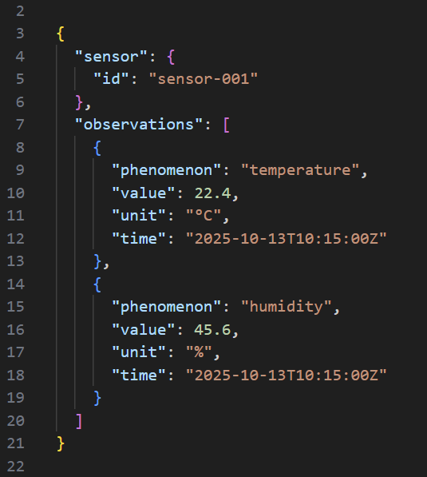

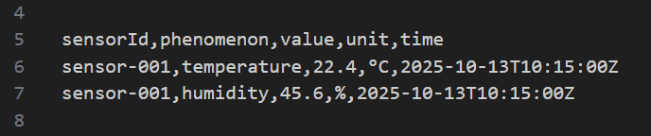
Research Question 2
Heterogeneous payload formats and character set encodings
For e.g. plain text, comma-separated values, and structured JSON
Model semantic payload metadata to enable parsing, interpretation, and integration
RQ2: How can heterogeneous payload formats and character encodings be represented in a semantic model to enable machine-interpretable integration of the transmitted data?
Data Engineering
6
Notes:
The pictures show that there are different ways to represent information in a payload. The payload in the first picture lacks a clear format (plain text), making it difficult to handle in a machine-interpretable manner. The second picture shows a CSV message with multiple lines and a header. It depends on the system configuration if a header is neccesary and if multiple lines are allowed (batchwise). The payload in the third picture shows a JSON format which enables a better machine interpretation of the information.
GOAL RQ3 (Next slide): Provide a clear structured payload representations, derived from observation semantics to integrate in SOSA

Slide 7
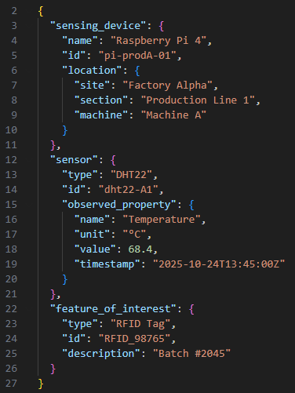
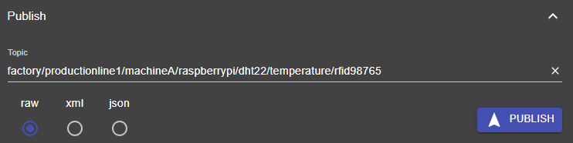
Research Question 3
Derived topic names and data structures from observation semantics
Hierarchical topics
Room, sensing device, sensor, observed property, and feature of interest
Structure and arrangement of payload content
column order in CSV or nested JSON syntax
RQ3: To what extent can semantic MQTT topic names and structured payload representations be derived from observation-related information, such as the observed feature of interest, the used sensor, and the observed property?
Data Engineering
7

Slide 8
Research Questions
RQ1: How can the MQTT message protocol be semantically represented in a way that aligns with an existing sensor network ontology, such as W3C SSN/SOSA?
RQ2: How can heterogeneous payload formats and character encodings be represented in a semantic model to enable machine-interpretable integration of the transmitted data?
RQ3: To what extent can semantic MQTT topic names and structured payload representations be derived from observation-related information, such as the observed feature of interest, the used sensor, and the observed property?
Data Engineering
8

Slide 9
Related Data Models
W3C SSN/SOSA
Most widely adopted standard for modeling Semantic Sensor Networks
Does not specify how data is transmitted or how protocols like MQTT interact with observation streams
WoT MQTT to RDF
Ontology draft, developed as part of the W3C WoT Binding Templates
Semantic representation of MQTT
Incomplete draft ontology
Does not consider sensing systems, such as SSN/SOSA
Data Engineering
9

Slide 10
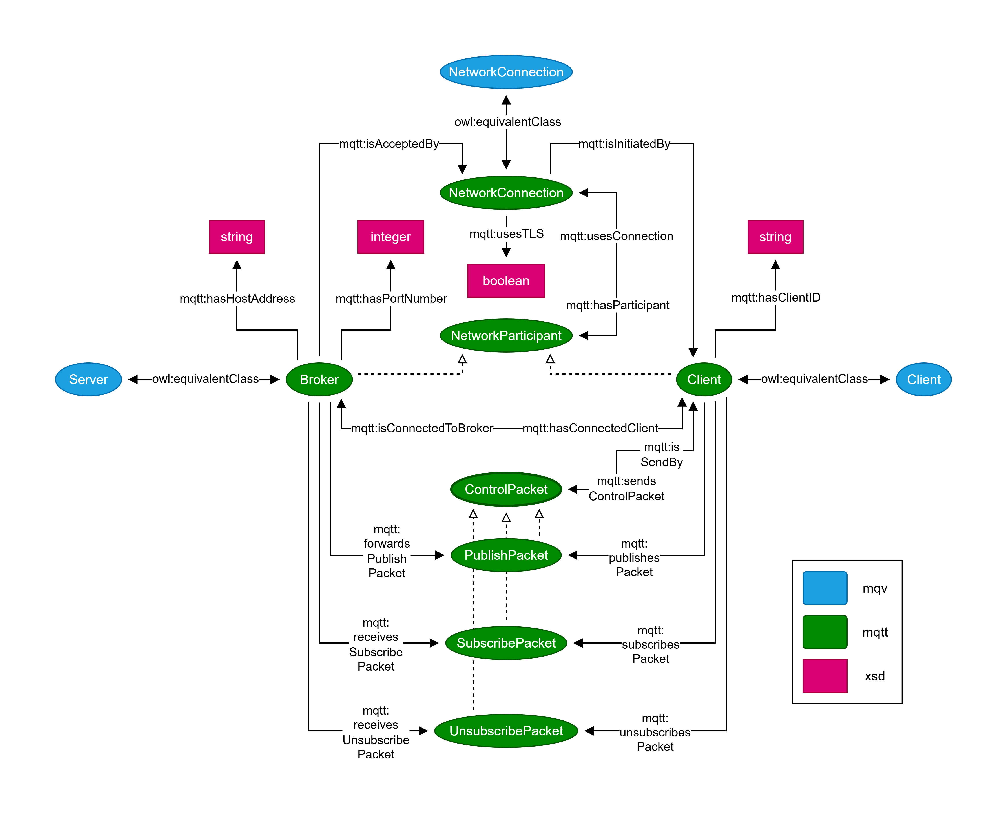
Network Infrastructure Relations
Data Engineering
10
Notes:
Client and Broker are subtypes of NetworkParticipant; interaction is mediated by the network connection. The connection is initiated by the client and accepted by the broker. Clients are linked to the control packets they send, while brokers can receive and forward them.

Slide 11
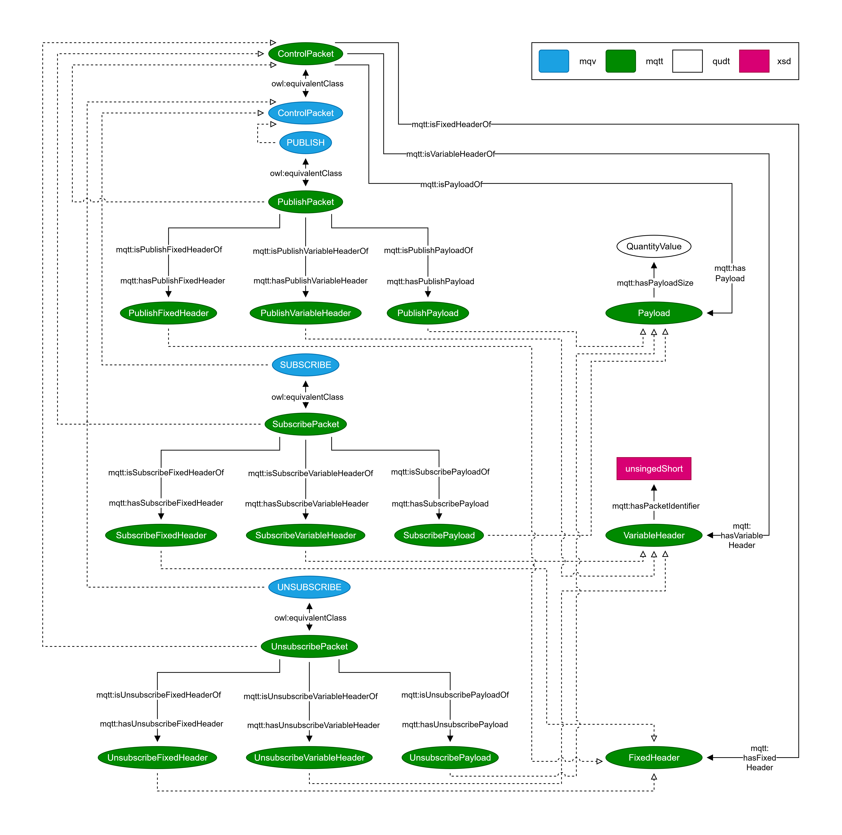
Control Packet Hierarchy
Data Engineering
11
Notes:
Publish, Subscribe and Unsubscribe Packets are subclasses of a general ControlPacket.
A ControlPacket is divided into FiexedHeader, VariableHeader and Payload. Depending on the type of control packet and its structure, there are specific subdivisions.

Slide 12
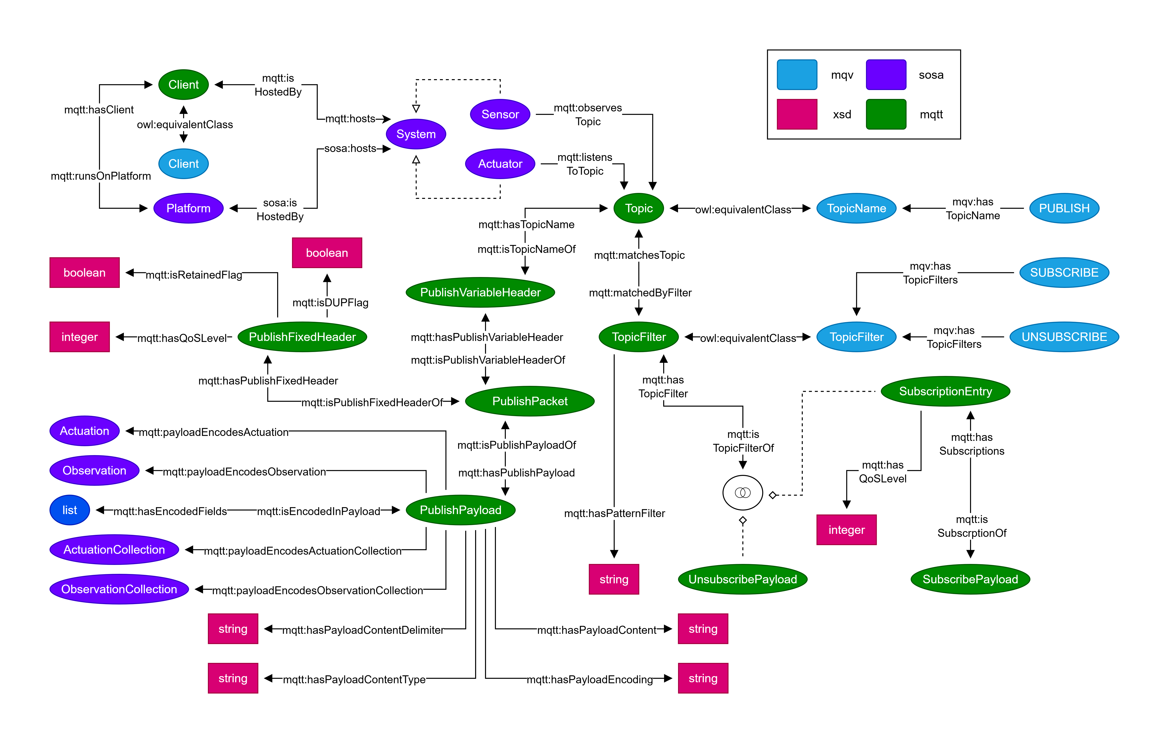
Topic and Payload Relations
Data Engineering
Notes:
Important on this slide is the „Publish Packet“. The PublishFixedHeader carries the QoS Level, DUP and Retained Flag. The PublishVariableHeader includes the Topic. The PublishPayload carries the Content with its metadata: PayladEncoding, PayloadContentDelimiter and PayloadContentType PublishPayloads can encode Acutation or Observations, possibly as Collections SOSA Sensors and Actuators can observe or listen to MQTT topics.
An MQTT Client runs on a SOSA Platform and hosts a System (Sensor, Actuator)

Slide 13
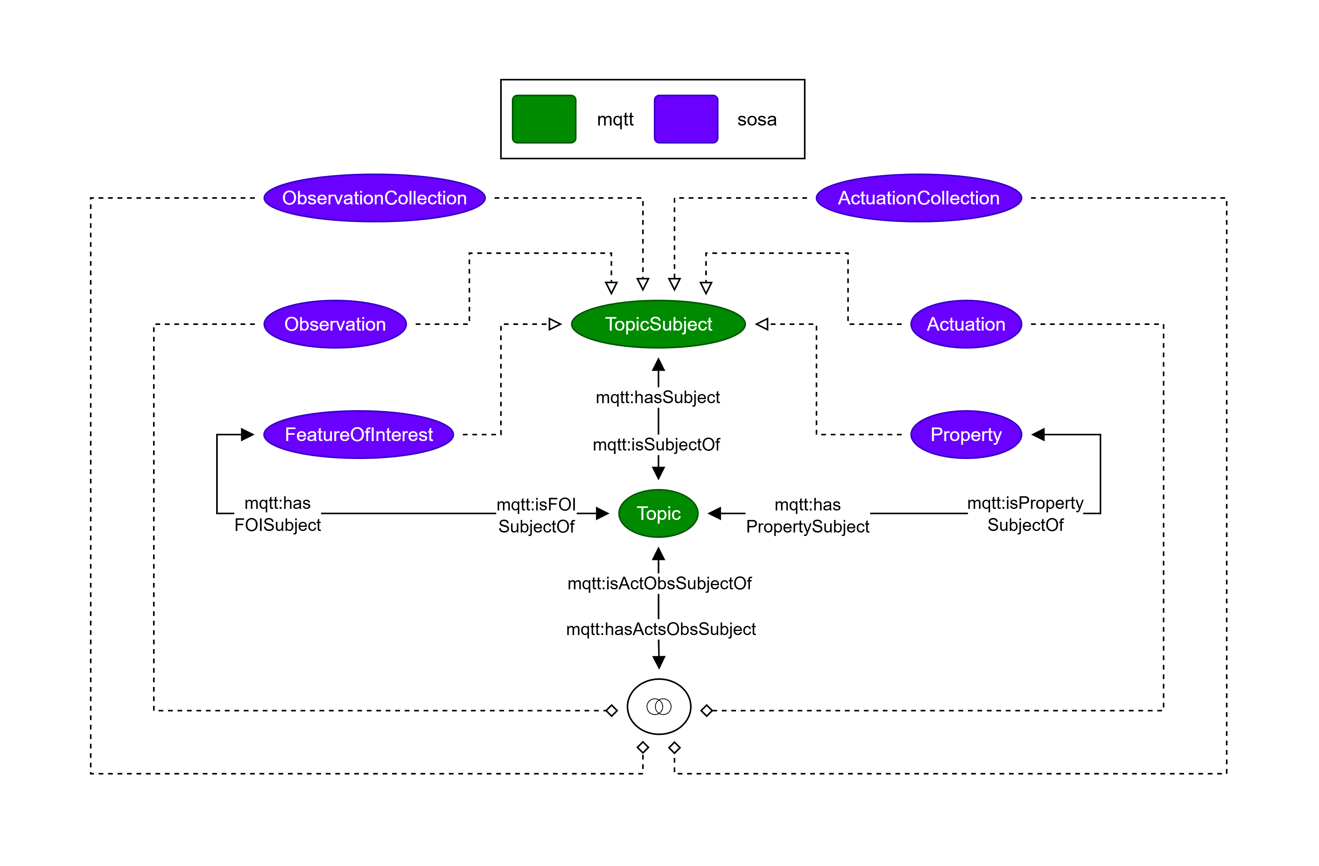
Topic Subject Relations
Data Engineering
13
Notes:
A MQTT Topic can be related to one or more topic subjects, represented by SOSA. The combination of observation or actuation (single or as a collection) with an associated feature of interest and property can describe a topic name.

Slide 14
Ontology Verification
Data Engineering
14

Slide 15
Conclusion
W3C SSN/SOSA
Ontology for Semantic Sensor Networks
Sensors, Actuators, Observations
Does not include M2M communication protocols
WoT MQTT to RDF
Work in progress draft, incomplete representation MQTT
Does not consider sensing systems
MQTT4SSN
Semantic modeling of the MQTT message protocol
Network Entities, Control Packets, Headers, Payloads, Topics
Addresses use cases with and without SSN/SOSA implementation
Heterogeneous payload formats, character encodings and transport metadata
Bridges the gap between sensor semantics and M2M communication semantics
End-to-end traceability and semantic interoperability across distributed IoT systems
Data Engineering
15

Slide 16
Future Work
Extending the model
MQTT 5: Message Properties, Session Control, user-defined Metadata
Cover all 15 types of Control Packets
Semantic Topic Naming
Automated derivation of Topic names from linked SOSA elements
Same for Payload content formats for e.g. CSV schema or JSON structure
Feature of Interest, Property, Actuation (Collection), Observation (Collection)
Linked semantic entities could reduce configuration effort and improve consistency
Evaluation
Set up a simulation environment
Emulate processes in industrial automation scenarios
Communication via MQTT
Data Engineering
16

Slide 17





Thank you for your Attention.
Any Questions?
Prof. Dr. Maria Maleshkova
Helmut Schmidt University, Germany
Data Engineering
maleshkm@hsu-hh.de
https://www.hsu-hh.de/dataeng/en/startpage/
https://doernern.github.io/MQTT4SSNOntology/documentation/index-en.html
Data Engineering
17
Notes:
Über den Link / QR-Code ist die Dokumentation zu erreichen. GitHub liegt unter https://github.com/doernern/MQTT4SSNOntology/

